Slide 1
Market Pulse Copilot
https://market-pulse-copilot-8wrk1wtvq-limingxuan513-commits-projects.vercel.app/

Slide 2
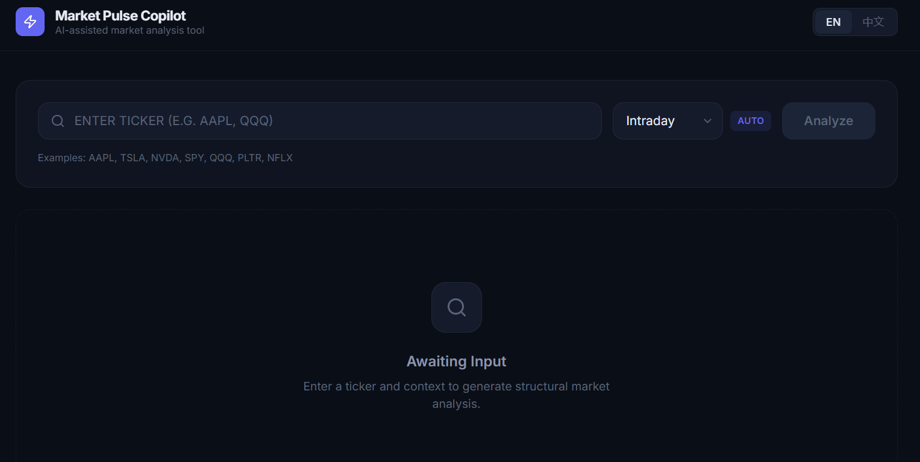

Slide 3
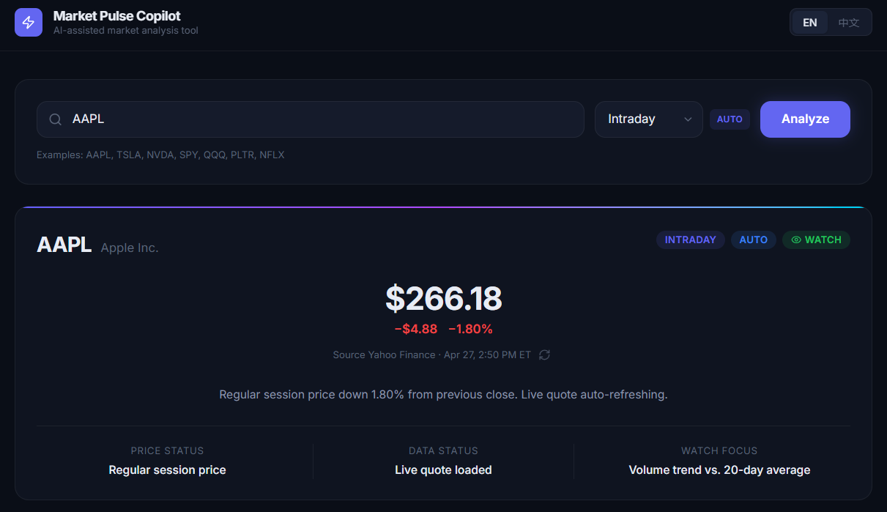

Slide 4
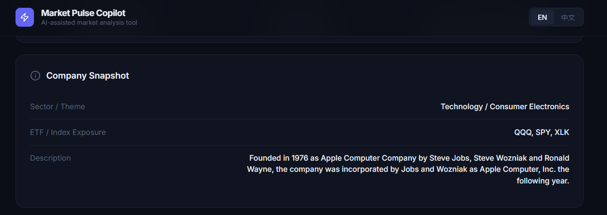

Slide 5
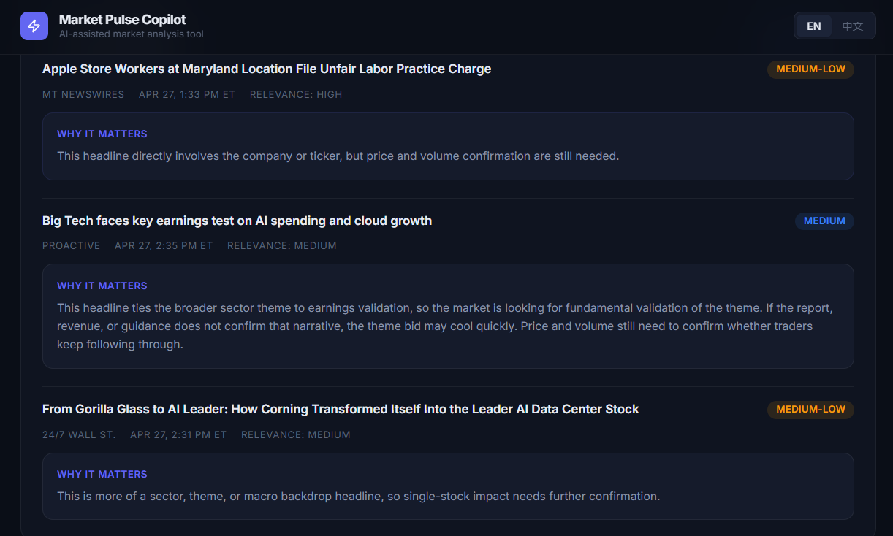

Slide 6
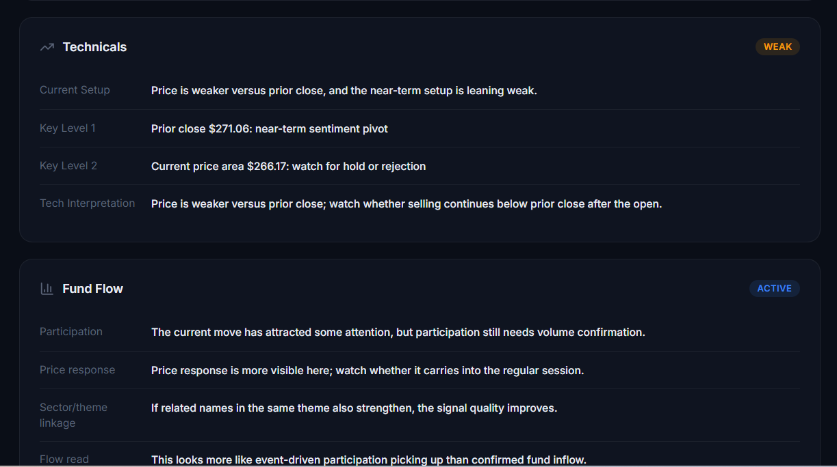

Slide 7
